Slide 1

BDAT 1004 – Final Project Python – Jupyter Notebook
Prepared by | Srilekha Sampath kumar
Student ID | 200499290
Due Date | 09-Dec-21
Presented to | Mohammed Jibran

Slide 2

Contents
Introduction to Dataset
Data Cleaning
Data Analysis
Data Visualization
Conclusion
References

Slide 3
Brief Introduction to Dataset

Slide 4

Introduction to Dataset
Link to the Dataset – Analytic Jobs
This dataset provides the information about the Big Data Analyst job market in 2020, also it provides the information about the revenue and employee scale of those companies which has big data analytics role.
Objective
The Objective of this assignment is to Clean the data, analyze the records in the data to provide some insights by dataset Visualizations.

Slide 5
Reason for Analysis
This analysis provides visibility to the job seeker on available job in the filed of Data Analytics around US.
Expected Outcomes
The outcome of this analysis will let us all know how is the job trend for Data Analytics in the year 2020 and the corresponding companies' revenues.

Slide 6
Information about the Dataset
The raw data downloaded from the Kaggle website consists of 16 columns with 2253 records.
S No | Field | Explanation
1 | S No | Unique Identifier
2 | Job Title | Title of the Job Requirement
3 | Salary Estimate | Minimum and Maximum Salary Estimate
4 | Job Description | Describing about the job Requirements
5 | Rating | Ratings provided by the employee in that company
6 | Company Name | Represents the name of the company
7 | Location | The location in which the jobs are available
8 | Headquarters | Headquarters of the company
9 | Size | Minimum and Maximum Employee head count of the Company
10 | Founded | The year in which the company was founded
11 | Type of ownership | Represents a company is run by public, private or non-profit organization.
12 | Industry | Represents the Industry of the company
13 | Sector | Represents the sector of the company
14 | Revenue | Minimum and Maximum Revenue of the Company
15 | Competitors | Provided the competitor of the company
16 | Easy Apply | Easy to apply for the job or not

Slide 7
Data Cleaning

Slide 8
Data Cleaning
Data Cleaning is done using Python in Jupyter Notebook.
Categorization of variables
Subcategorized Revenue, Salary estimation and Size of the company variables into the following as ranges were provided,
Minimum Salary in 1000 USD
Maximum Salary in 1000 USD
Minimum revenue
Maximum revenue
Minimum size of the company
Maximum size of the company

Slide 9
Categorization of variables
In competitor variable there were company names and -1 values.
Company name represents the brand value of the organization and -1 represents that there are zero competitors.
The variable is cleaned to represent the two following categories,
Competitor names
No
Categorization of values
Various job titles are categorised and merged into 6 unique titles which are apt for wide market range like Data Analyst, Senior Data Analyst, Business Analyst, Data Quality Analyst, Data Scientist, Data Security Analyst.
Various Ownership types are categorised and merged into 7 unique titles such as Non-profit Organization, Private, Health, Government, Educational, Contract and Subsidiary or Business segment.

Slide 10
Missing value analysis
Entire dataset has been checked for NULL/NA, any missing/empty values or other irrelevant values.
Removed records filled with -1, as they are not meeting with any sort of clues to fill in the data. As a result, nearly 1000 records are eliminated.
Column ‘S No’ has been checked for Duplicate values. As no duplicates are found, this column can be considered as primary key.

Slide 11
Data Cleaning Results
Total number of Records : 875 Rows
Total number of Fields : 16 Columns
S No | Field | Explanation
1 | S No | Unique Identifier
2 | Company Name | Represents the name of the company
3 | Job_Title | Title of the Job Requirement
4 | MinSalary_in_1000USD | Minimum salary provided by the company
5 | MaxSalary_in_1000USD | Minimum salary provided by the company
6 | Rating | Represents the name of the company
7 | Location | The location in which the jobs are available
8 | Headquarters | Headquarters of the company
9 | Minimum_Empsize | Minimum size of the employees in the company
10 | Maximum_Empsize | Maximum size of the employees in the company
11 | Founded | The year in which the company was founded
12 | Type of ownership | Represents a company is run by public, private or non-profit organization
13 | Sector | Represents the sector of the company
14 | Minimum_Revenue_in_Million | Provides minimum revenue produced by the company
15 | Maximum_Revenue_in_Million | Provides maximum revenue produced by the company
16 | Competitors | Provided the competitor of the company

Slide 12
Data Analysis

Slide 13
Research Questions
Different types of Jobs available in the Dataset.
How much is the maximum revenue with different type of organizations?
Top 5 cities with maximum Job Opportunities

Slide 14
Data Visualization
The analysis results are presented in visual format using Python

Slide 15
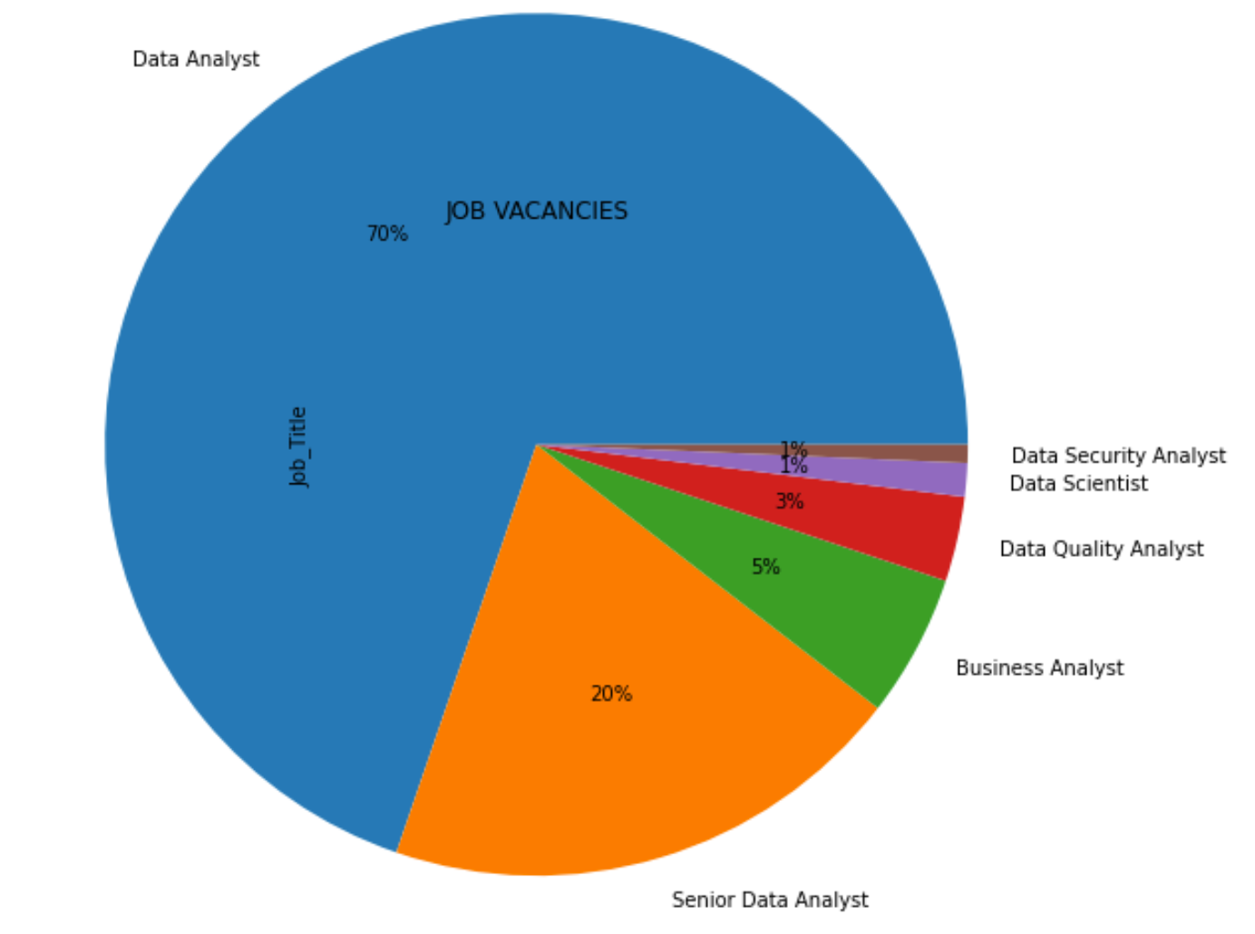
Different types of Jobs available in the Dataset.

Slide 16
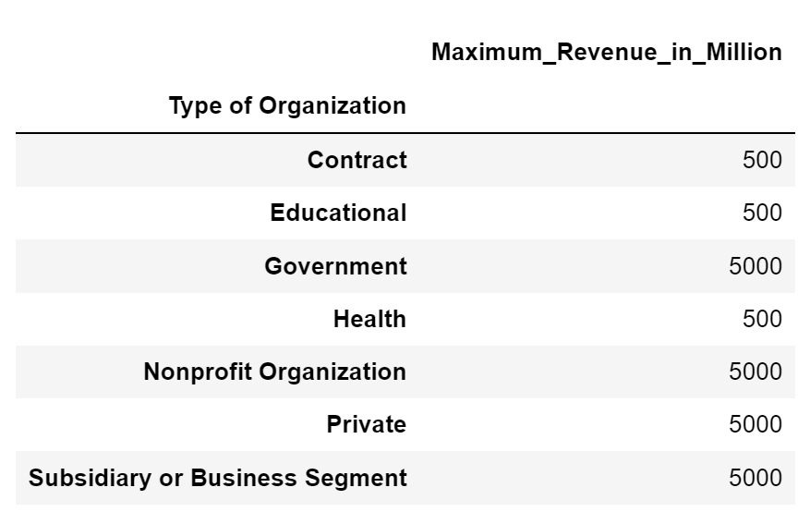
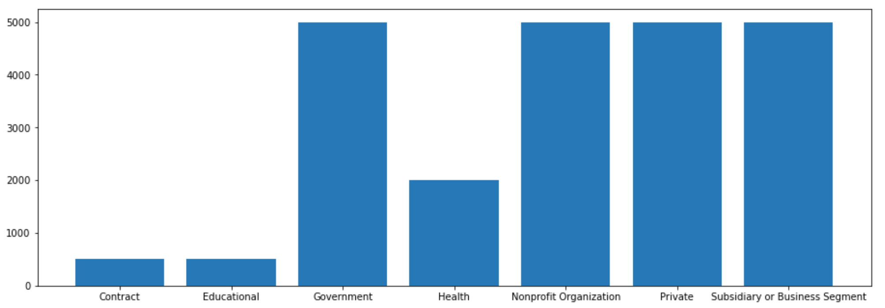
How much is the maximum revenue with different type of organizations?
From this chart we could see all the major organization has the maximum revenue, except educational, health and contract which has the least revenue.

Slide 17
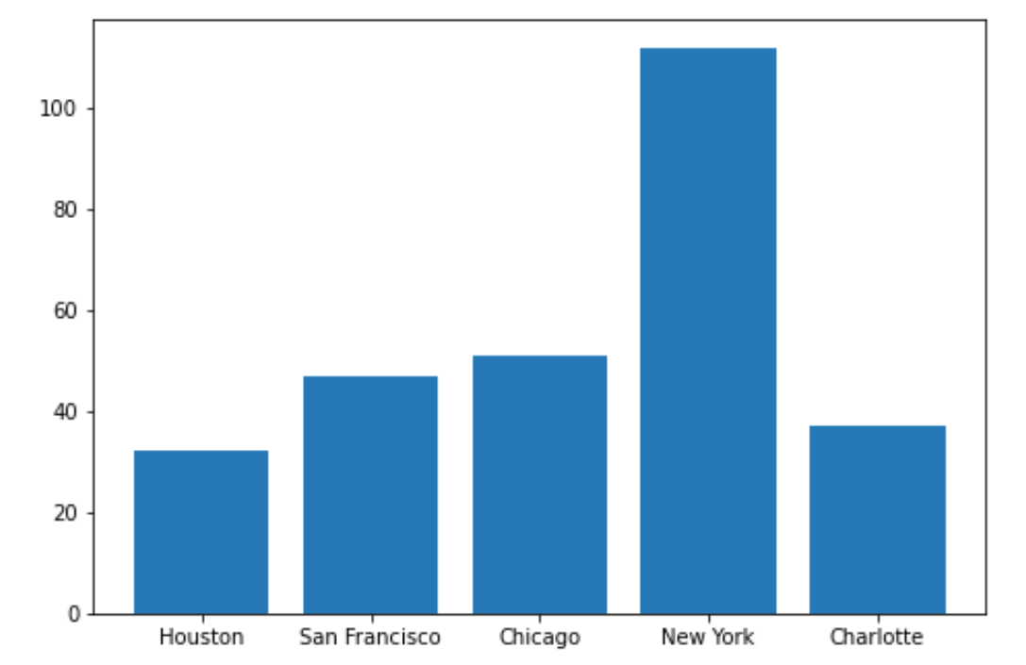
Top 5 cities with maximum Job Opportunities
To know the top 5 cities, employee ratings column is taken into consideration, using the Pivot table. According to the count of the rating, we could see the New York city has the more ratings count followed by Chicago and San Francisco and so on.

Slide 18
Conclusion
From all the analysis below are the outcomes,
Among all the cities, New York, Chicago and San Francisco are the top three cities which serves most of data jobs and among those San Francisco provides highest pay and average rating.
Recommendation
The job seeker can see the company founded year and apply job in that company as we could see age of the company has some impact on the revenue of the company.

Slide 19
References
Lecture material from Black board
College, C. (2021, 12 02). blackboard . Retrieved from blackboard:
https://gc.blackboard.com/webapps/blackboard/content/listContent.jsp?course_id=_319149_1&content_id=_6120540_1&mode=reset
GitHub link for Code Repository,
https://github.com/Srilekha235/Python_Data-Analysis-Final-Project_DP_Srilekha_200499290

Slide 20

Thank You
for Listening!
Any Questions?

